Slide 1
Learning Safe Cooperative Policies in Autonomous Multi-UAV Navigation
Arshdeep Singh
Indian Institute of Technology Ropar
2019csm1001@iitrpr.ac.in
Shashi Shekhar Jha
Indian Institute of Technology Ropar
shashi@iitrpr.ac.in

Slide 2
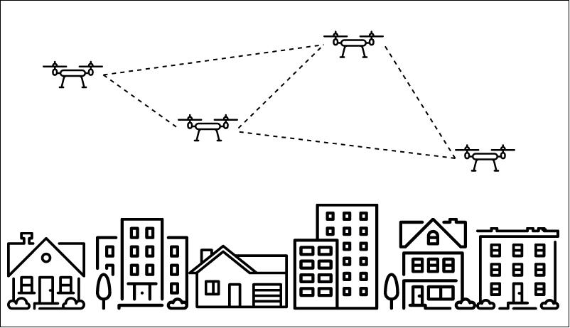
Problem Formulation
Multi-UAVs learning to autonomously reach their target destination through safe navigation
Each UAV should avoid collision with other UAVs
Formulated as a Multi Agent Reinforcement Learning(MARL) [1] problem
MARL is when we are considering various intelligent agents interacting with an environment
Multi Agent scenario
Cooperative

Slide 3
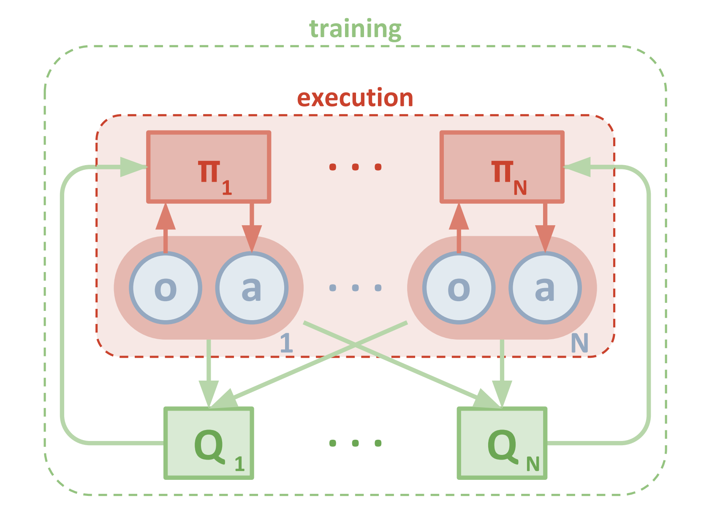
MADDPG (Lowe et al)[2]
Multi Agent Deep Deterministic Policy Gradient
Centralized Critic network, Decentralized execution (multiple independent Actors), Deterministic Policy function
Architecture
An actor network for using observations for deterministic actions
An identical target actor network for training stability
A critic network that uses joint states action pairs to estimate Q-values
MADDPG[2]

Slide 4
Issues
No obstacle avoidance : static, dynamic
No safety guarantees
Large state space configuration
Techniques
Safety Controllers[3]
Control Barrier functions[4]

Slide 5
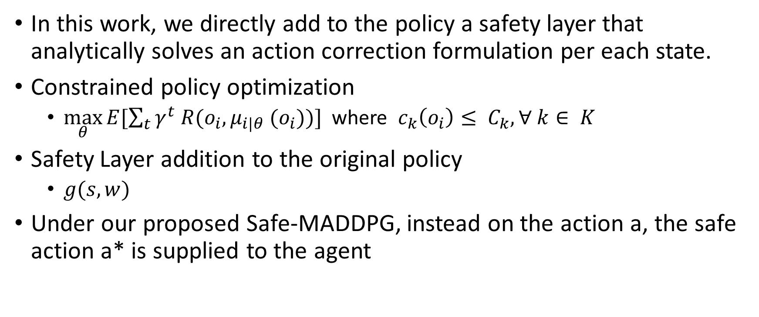
Safety Layer(Dalal et al)[3]
In this work, we directly add to the policy a safety layer that analytically solves an action correction formulation per each state.
Constrained policy optimization
$\max_{θ}{E[\sum_{t}{γ^{t} R(o_{i}, μ_{i|θ} (o_{i}))}]}$ where $c_{k}\left(o_{i}\right)≤ C_{k}, ∀ k∈ K$
Safety Layer addition to the original policy
$g(s, w)$
Under our proposed Safe-MADDPG, instead on the action a, the safe action a* is supplied to the agent

Slide 6
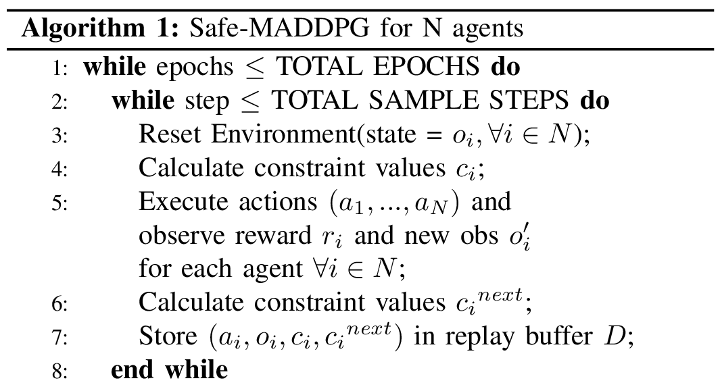
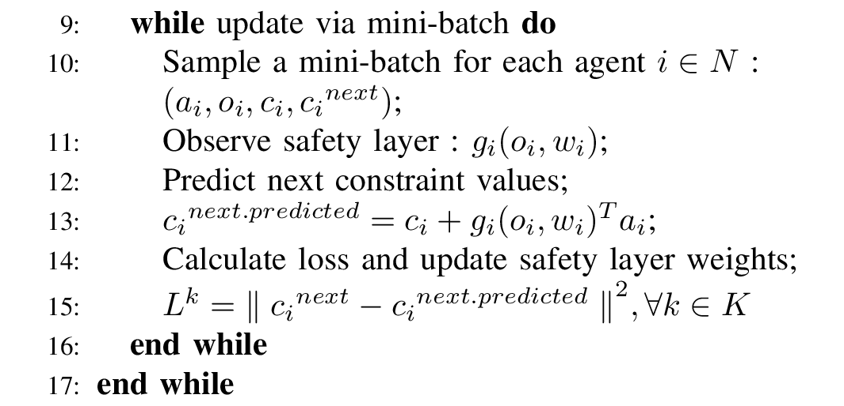
Safe-MADDPG
Step 1
Safety Network update

Slide 7
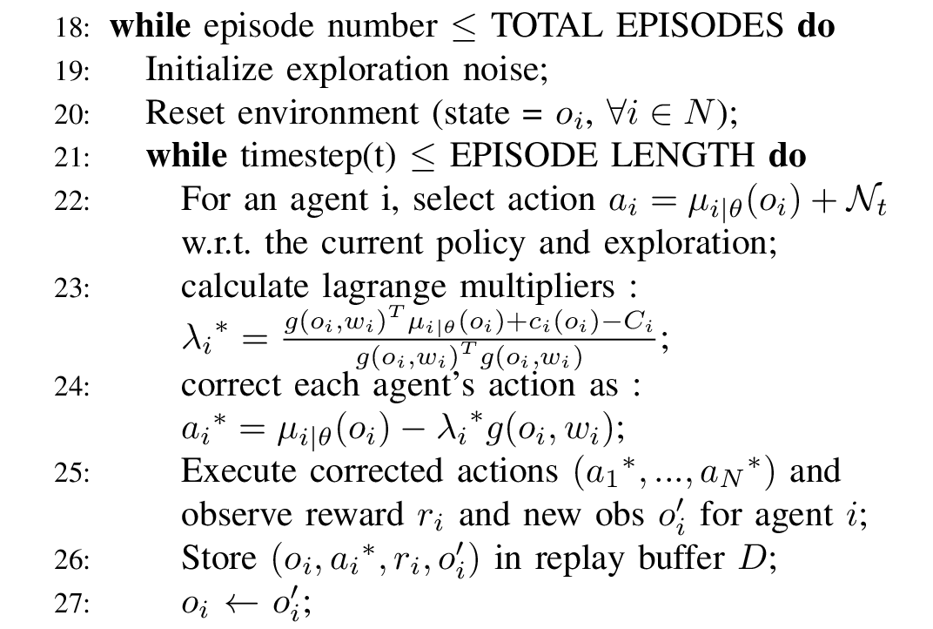
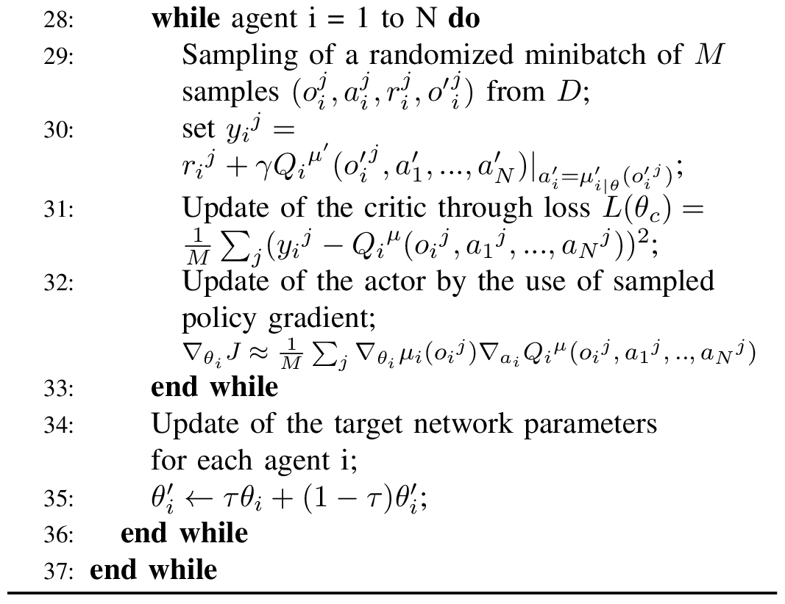
Safe-MADDPG
Step 2
Next

Slide 8
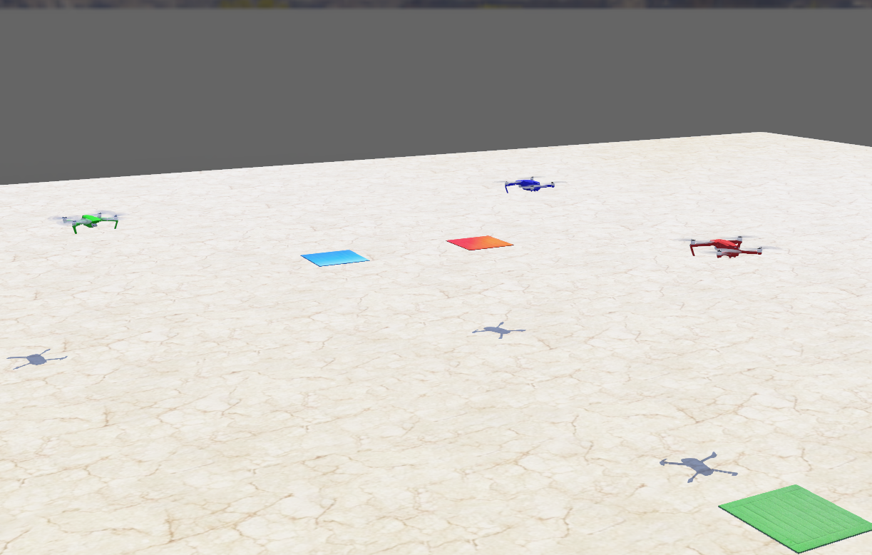
Experimentation
Multiple UAVs and their Target locations
UAV : DJI Mavic
Webots Simulation by Cyberbotics[5]
Real world physics engine
Webots Environment

Slide 9
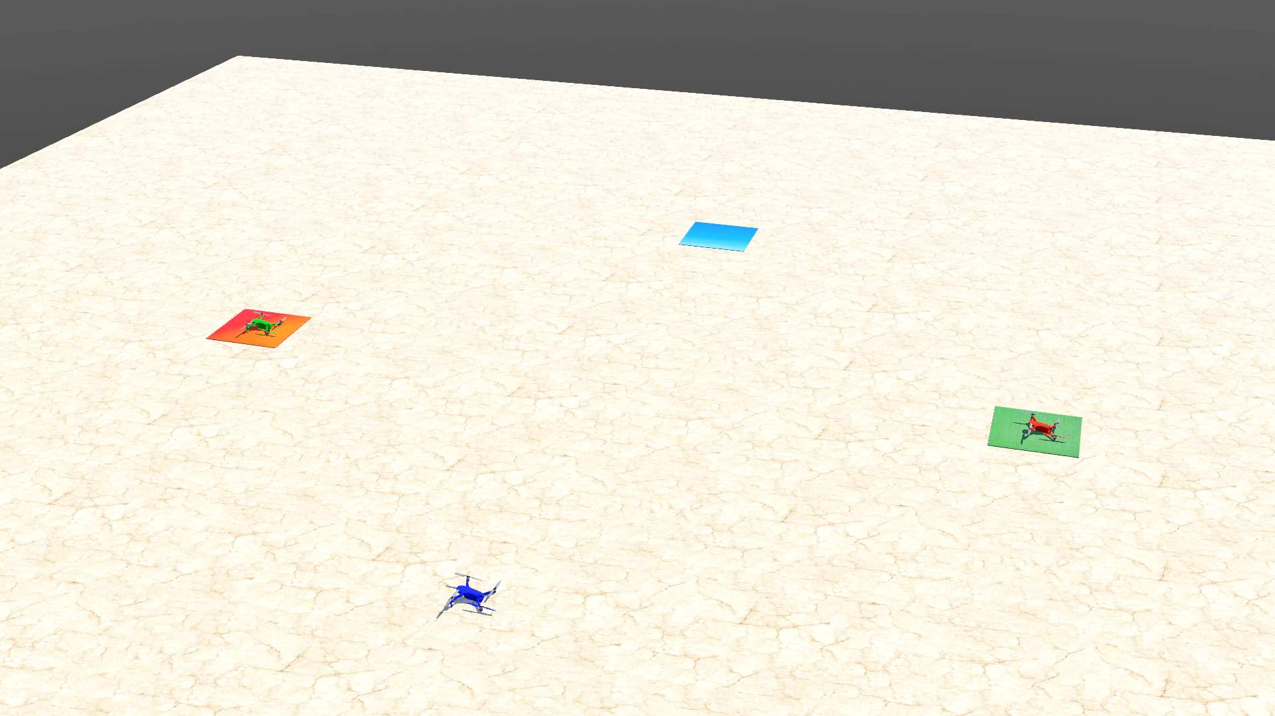
Results (3 UAV scenario)

Slide 10
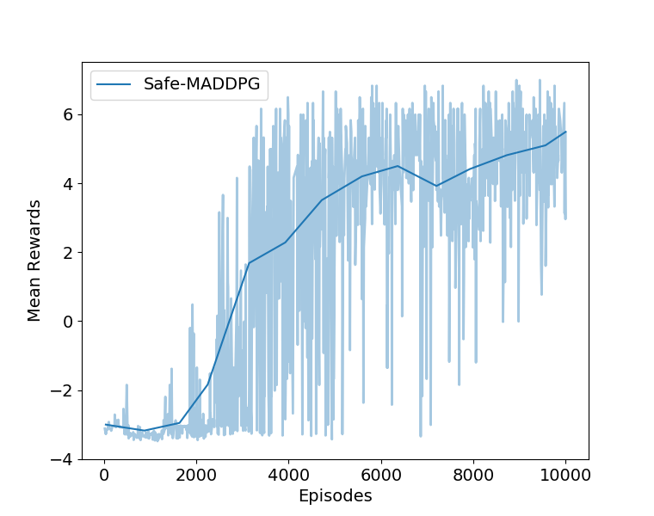
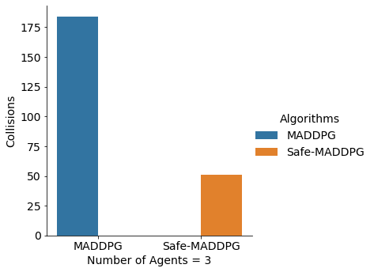
Evaluation
Mean Rewards
Testing final policies

Slide 11
References
Deep Reinforcement Learning (researchgate.net)
R.Lowe, Y.Wu, A.Tamar, J.Harb, P.Abbeel, and I. Mordatch, “Multi-agent actor-critic for mixed cooperative-competitive environments,” CoRR, vol. abs/1706.02275, 2017.
G.Dalal, K.Dvijotham, M. Vecerık, T. Hester, C.Paduraru, and Y.Tassa, “Safe exploration in continuous action spaces,” CoRR, vol. abs/1801.08757, 2018.
R.Cheng, G.Orosz, R.M.Murray, and J.W.Burdick, “End-to-end safe reinforcement learning through barrier functions for safety-critical continuous control tasks,” in Proceedings of the AAAI Conference on Artificial Intelligence, vol. 33, 2019.
Webots, “http://www.cyberbotics.com,” open-source Mobile Robot Simulation Software. [Online]. Available: http://www.cyberbotics.com.

Slide 12
Thank You!

